Slide 1
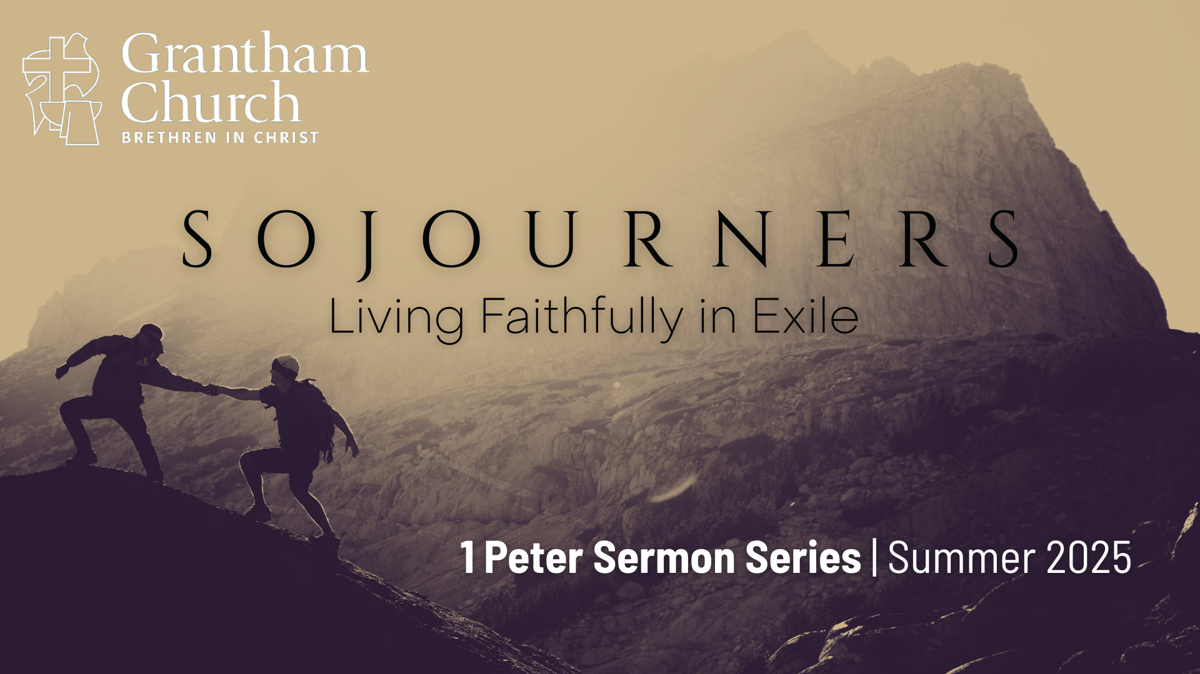
Notes:
We are continuing our verse-by-verse journey through 1 Peter in our summer sermon series, Sojourners: Living Faithfully in Exile. In Peter’s first epistle, as well as the rest of the New Testament, followers of Jesus are often referred to as resident aliens, strangers, foreigners, sojourners, and “exiles” in this present evil age.
In a world that often feels like it’s not our home, how do we live with courage, integrity, and purpose as disciples of Jesus? In this letter, Peter writes to Christians in the first century who are living throughout Asia Minor and experiencing challenges to their faith. And so, he offers them wisdom for navigating hardships, cultural pressure, and spiritual struggles. Therefore, we’re exploring what it means to be God’s chosen people—set apart for his plan and purposes in the world—as we learn how to embrace our identity in Christ, endure suffering with a deep trust in the Lord, and to live as hopeful witnesses of Jesus in a hostile world.
This is week 4 of our series. If you’re just joining us or you could use a brief review, here is what we’ve covered so far… [NEXT SLIDE]

Slide 2
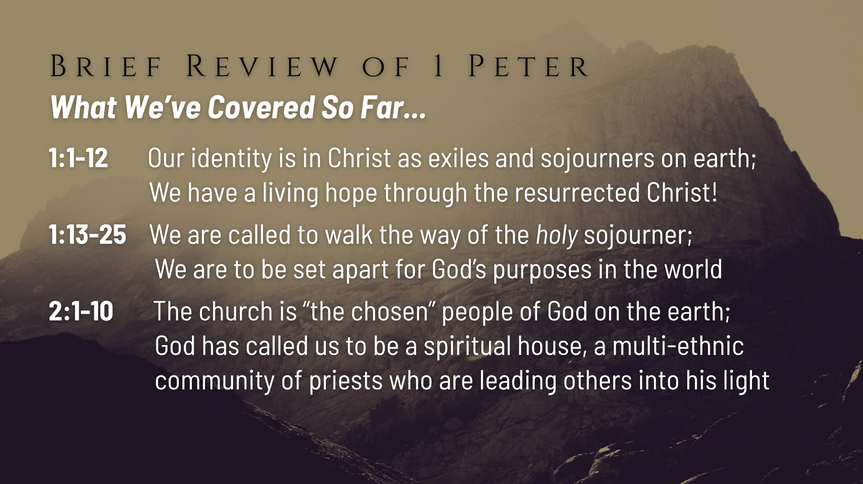
Notes:
Peter began his letter by reminding these believers that their identity is not to be found in the world but in Christ, who has given us what he says is a “new birth into a living hope through the resurrection of Jesus Christ from the dead.” It’s because of this new identity in Christ and belief in God’s good future that we can follow Jesus and live faithfully in exile.
And then two weeks ago, we heard Peter invite us to walk the way of the holy sojourner. We are to be holy as God is holy; meaning we are to be full of light, love, and the life of God. We’re called to become like the God revealed in Jesus and be set apart for his purposes in the world, as we love God and one another deeply from the heart.
And then last week we heard Peter use old covenant language about Israel and apply it to God’s new covenant people, the Church. Peter, a Jewish apostle, says that we (Jew & Gentile followers of Jesus) are ”the chosen” people of God on the earth. We are called to be a ”holy nation”, a spiritual house, and a multi-ethnic community of priests who are leading others into his wonderful light. And we are to do that wherever God has placed us in this world.
That brings us to today’s message in 1 Peter chapter 2, verses 11-25… [NEXT SLIDE]

Slide 3
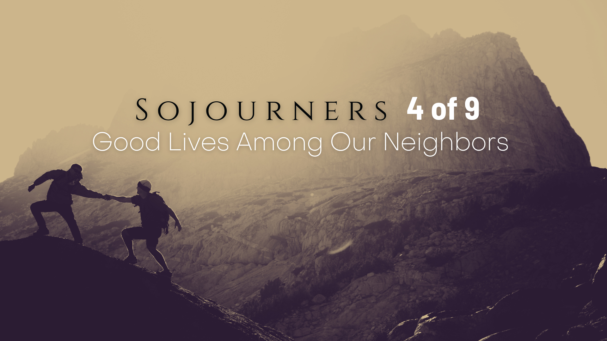
Notes:
We will hear Peter urge us to see ourselves as sojourners and exiles who abstain from sinful desires and submit to authorities as a witness to God’s love and power. If we’re going to follow Jesus, we must be willing to be misunderstood, treated unfairly, and suffer for Christ in a watching world. This may be the only way that some unbelievers see the power of the gospel. And so, we’re going to hear the invitation to live what Peter calls “good lives” among our neighbors and faithfully follow the example of Jesus when the world turns against us.
But before we begin reading and unpacking the Scriptures together, let’s pray and prepare our hearts to receive a word from the Lord.
[BRIEF PRAYER]
1 Peter chapter 2, beginning with verse 11… [NEXT SLIDE]

Slide 4

Notes:
NOTE: 1 Peter 2:11 begins a new section in this letter. Starting with 2:11—going through 4:11—Peter shares how our response to suffering is a way of bearing witness to Jesus.
[READ VERSES 11-12] – Our theme verses for this series
v. 11 – “Friends” or “beloved” - Peter urgently and affectionately pleads with them; as “foreigners and exiles” (NIV) or “temporary residents” (NLT) or “aliens and exiles” (NRSV) or “sojourners and exiles” (ESV) - What is a sojourner? We’re talking about a temporary resident, a stranger, or a traveler who dwells in a place for a limited period, not considering it as their permanent home. It carries the idea of being on a journey, a pilgrim on the road, often dependent on the hospitality of others. And in this case, a deep faith or trust in God to provide protection and provision as we follow Jesus in a broken and fallen world.
“abstain” (NIV) or “keep away” (NLT) or “deliberately avoid” desires that are “fleshly” or “carnal” that involve all manner of ungodly inclinations that “wage war” against your soul/life. Peter doesn’t give us a list of those desires and behavior, but it likely involved those mentioned in 2:1 – “malice and all deceit, hypocrisy, envy, and slander” – and in the Greco-Roman world it would typically involve various forms of idolatry and twisted sexual activity. But notice that Peter says these “desires” are like a hostile army doing spiritual battle. For example, in the Sermon on the Mount, Jesus will go to the root of adultery, which is lust; or the root of murder, which is harboring hate in the human heart. And so, Peter says, “abstain” or “run away” or “be intentional about avoiding” these desires that lead to acts of the flesh.
Verse 12… [NEXT SLIDE]

Slide 5
Notes:
[READ VERSE 12 & COMMENT]
v.12 – In his commentary on 1 Peter, NT scholar Dennis Edwards writes: “An identifying mark of God’s ownership of the Christian community is its distinction, morally, from the rest of those around them. God’s people must live qualitatively different lives even while they live in close proximity with those whose values and actions are contrary to God’s” (pg.102)
And as historical studies show, early Christians did live differently, and many unbelievers were attracted to the gospel because they saw that Jesus-followers upheld moral standards that were necessary and profoundly important for human welfare. And the ethical and moral behavior of Christians held a mirror up to evil in Roman society. Of course, we also see examples of Christians that were accused of being anti-patriotic, haters of society; disturbers of the peace, and charged with detestable things like cannibalism, incest, and atheism. [EXPLAIN FURTHER]
Which is likely why Peter says, “live such good lives—i.e., God-honoring lives—among your unbelieving neighbors that, though they may accuse you of doing wrong, they may see your good deeds and glorify God when the Lord returns.” And so, it begs the question, are we living such good lives among our neighbors that it merits false accusations like these? And maybe another question, Will they in time-–because of our faithfulness—see the truth and the beauty of the gospel and eventually give glory to God in the end?
As we heard last week… that is why Jesus said in Matthew 5:16… [NEXT SLIDE]

Slide 6
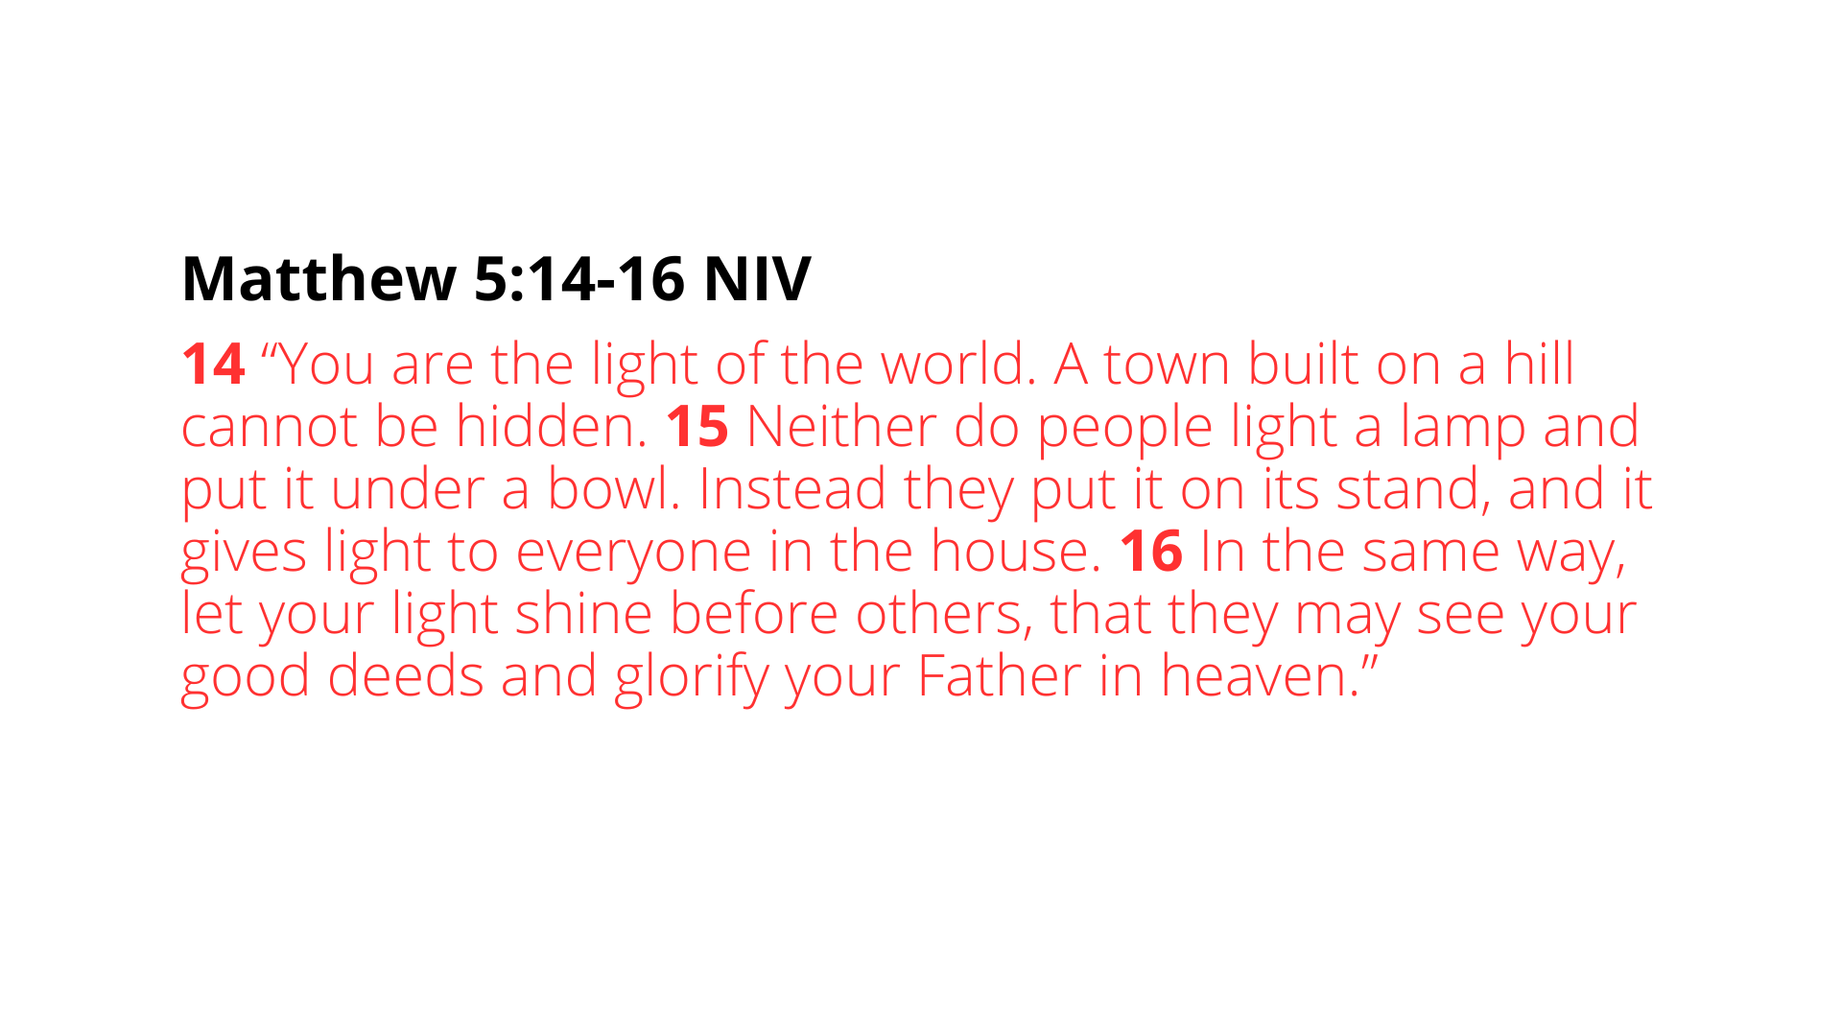
Notes:
”Let your light shine before others, that they may see your good deeds and glorify your Father in heaven.” So, when the day of his return comes—that day of judgment, that day of reckoning—will it be said of us that our lives burned brightly for Jesus in the way that we sought to be holy and set apart—in the way that we were willing to go against the tide of American culture? Will others have come to Christ through our shining example because we stood against the raging torrent of fear and suspicion, racism and hatred, greed and power,, pornography and sexual perversion, nationalism and imperialism? Let us pray that they will see that in us; that they will see Christ in us because we refused to choose our own tribe and our own comfort over the desperation of immigrants, refugees, and weary travelers seeking safety for their families.
Because that is (or is at least supposed to be) who we are: as the author of Hebrews wrote about the OT saints, they were sojourners who were looking for a country of their own—a heavenly one. And so, we must adjust our hearts and minds, as Peter says, to live as aliens and exiles on the earth. Going back to when Jeremiah wrote a letter to the exiles in Babylon, we should adopt the same mindset in how we live in relationship to this world… [NEXT SLIDE]

Slide 7
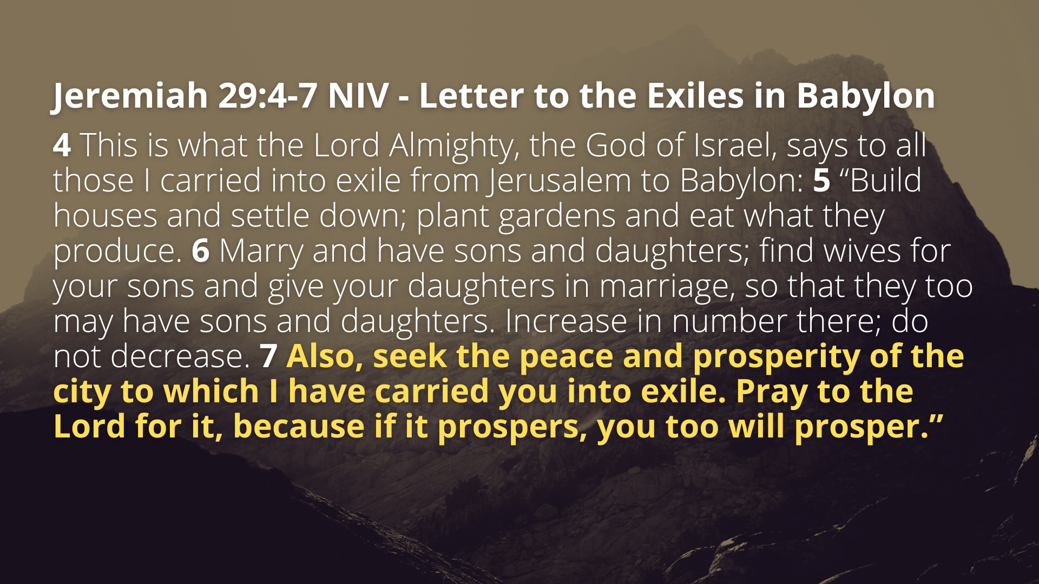
Notes:
[READ PASSAGE & COMMENT]
In other words, God is saying to us as exiles…
The world as it is now is not your real home, but be present and live life
But remember who you are as you seek the common good and bless your unbelieving neighbors
Back to 1 Peter, verse 13…. [NEXT SLIDE]

Slide 8
Notes:
[READ VERSES 13-17]
v. 13-14 – “Submit” or “subordinate” in this context is to recognize a position of authority; We don’t do this because they are always upstanding people worthy of honor and respect; notice, we do it for “the Lord’s sake” and acknowledge that these people serve a divine purpose, as Paul will say in Romans 13:1-5. This doesn’t mean that they can do no wrong. In fact, when they do wrong, there is biblical precedent for speaking truth to power. However, there are clear warnings in Scripture (particularly with Jesus) that violent rebellion against them is out. As Jesus said, ”Am I leading some sort of rebellion that you would come to me with clubs and swords?”
v. 15 – this “doing good” is what is required to “live good lives among the pagans”; it is about having the attitude and posture of Jesus in the face of baseless accusations, rumors, misunderstandings, slander, and “stupid talk” from ignorant (i.e., dumb on purpose) people. If we will respond with moral goodness and in love toward our enemies, we will eventually silence them.
v. 16 – Don’t use whatever freedom you have as a “cover-up” or “to veil” dark deeds. Be careful that your “freedom” as an American citizen or your “freedom” as a Christian (which are two totally separate things, btw) gives you license to lapse into licentiousness and sin. As Peter Davids writes in his commentary, “Your freedom in Christ is not a release from bondage into a state of autonomy, but release from bondage to become a salve of God. Only in God’s joyful slavery is their freedom.” As Paul wrote to the Galatians: “do not use your freedom to indulge the flesh; rather, serve one another humbly in love” (5:13).
v. 17 – Notice that “fear (or reverence) God” comes before “honor the emperor/king” as he intends to communicate that the submitting to governing authorities does not supersede obedience to God. Just think back to the prophet Daniel or Shadrach, Meshach, and Abednego living in Babylonian exile. Despite King Nebuchadnezzar's orders… Daniel still prayed to his God, and the three men did not bow down to the golden statue. So, Peter is not advocating unconditional obedience to governing authorities. But we can certainly say that he is prohibiting lawlessness, rebellion, and an antagonistic attitude toward authority.
And then Peter applies this to several roles in the home through what is known as “household codes” of that time. He will address those who are slaves and then wives and husbands. Next week Pastor Melissa will cover the section on wives and husbands. Today, we will just be looking at what he says to slaves. Verse 18… [NEXT SLIDE]

Slide 9
Notes:
[READ VERSES 18-20]
v.18-20 – In the Roman Empire, slavery was not based on race but rather on war captives, abandoned children, debt slaves, and the offspring of slaves. Scholars estimate that somewhere between 10–30% of the population of the empire were enslaved during the first century. Slavery was pervasive, especially in urban centers like Rome, where slaves may have made up 30–40% of the population. So, slavery was common. It was a major institution that was part of the Roman way of life. And so, imagine the situation of a slave who comes to Christ. They realize they are free in Christ (equal to their masters) and they have the difficult task of not only being subordinate, but also of living out their Christian faith. And yet, they do it, because they realize that the best way to open the eyes of their master isn’t to rebel against them but to reflect Christ in their service and win them over.
Of course, many of us are familiar with how slave owners in the American South used verses like these to support and defend the institution of slavery, but we can confidently say that this was a gross misuse of Scripture. Folks, remember, the writers of the New Testament are not privileged people in power. They themselves are speaking from the lower strata and echelons of Roman society. They are all experiencing injustice in one form another. And so, when Peter or Paul tell slaves to “submit” to their masters, they are not advocating for the institution of slavery and turning a blind eye to injustice, but rather for the character and faithful obedience of Jesus, wherever you find yourself. In time, Christianity will most certainly lead the effort in dismantling slavery in the West; the trajectory is being set. But encouraging a slave revolt wouldn’t be Christ-like in any form or fashion.
And think about it this way. I like how the writers of the Upside-Down Kingdom Bible frame it in their study Bible notes… [NEXT SLIDE]

Slide 10
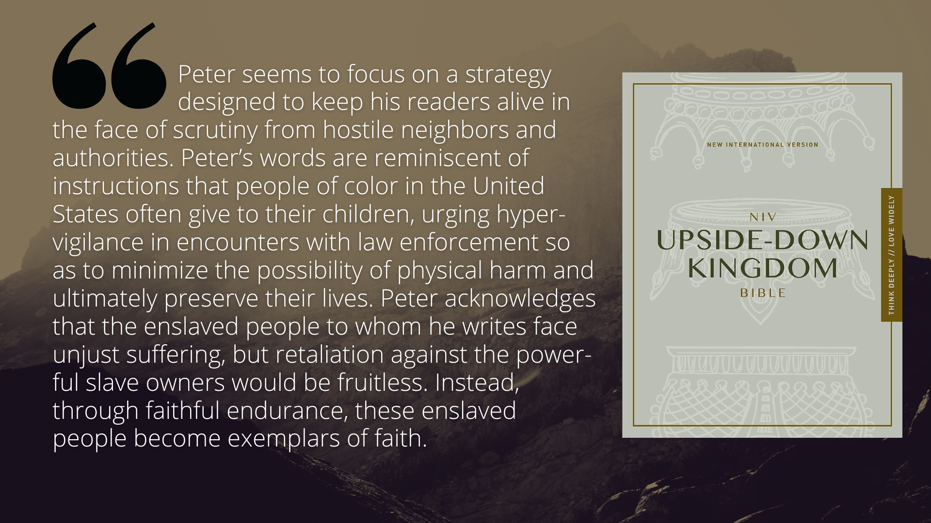
Notes:
[READ QUOTE & COMMENT]
And now the remaining verses in our reading for today. Verses 21-25… [NEXT SLIDE]

Slide 11
Notes:
[READ VERSES 21-25]
v. 21 – What example? Peter describes what he has in mind in the next few verses. And it appears that Peter is including an early church creedal confession based on Isaiah chapter 53—the well-known Suffering Servant passage, which speaks of the sufferings of Christ long before they happened.
v. 22-25 – Peter is calling all slaves of God to follow the Lamb of God when we undergo unjust suffering; trusting the Lord to vindicate us and judge the wicked in his time. And like what we see with the Roman centurion at the foot of the cross, if we (like Christ) live a good life and suffer unjustly for it, God can use it to change the hearts and minds of our persecutors. And we will be rewarded for it.
Remember what Jesus said in Matthew 5:38-42… [NEXT SLIDE]

Slide 12
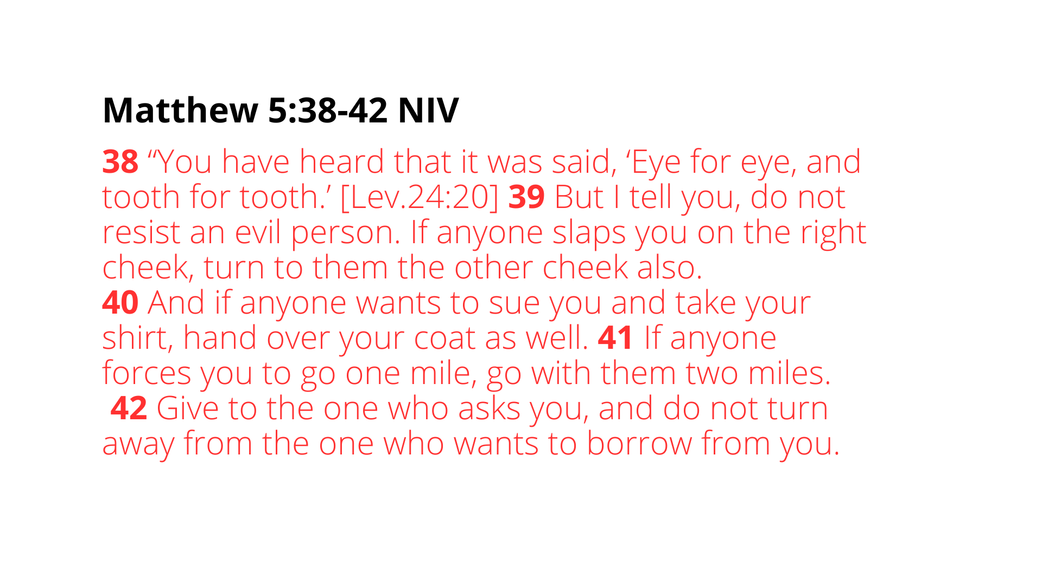
Notes:
[READ PASSAGE & COMMENT]
Jesus is advocating for a merciful and loving response to insults and violence
Doing good to those who hurt you, rob you, insult you, or take advantage of you is the Lord’s way of exposing the evildoer and lovingly positioning them to repent
Listen to what Paul wrote to the Christians in Rome… [NEXT SLIDE]

Slide 13
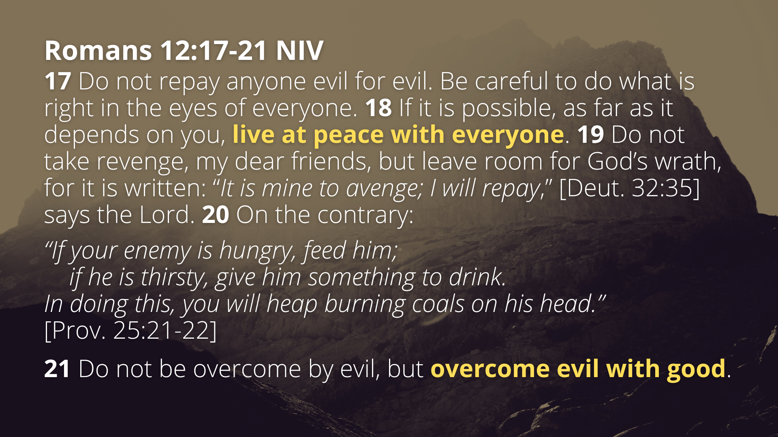
Notes:
[READ PASSAGE & COMMENT]
"Heap burning coals on his head" was a metaphor for producing deep moral discomfort or shame, intended to bring about repentance or a change of heart. Because when you respond to hostility with kindness, you expose the wrongdoing of your enemy more clearly. It's not about vengeance, but about love and moral transformation.
Let’s sum up what we’ve read in 1 Peter today. Here are some takeaways and application based on what we’ve covered in this message… [NEXT SLIDE]

Slide 14
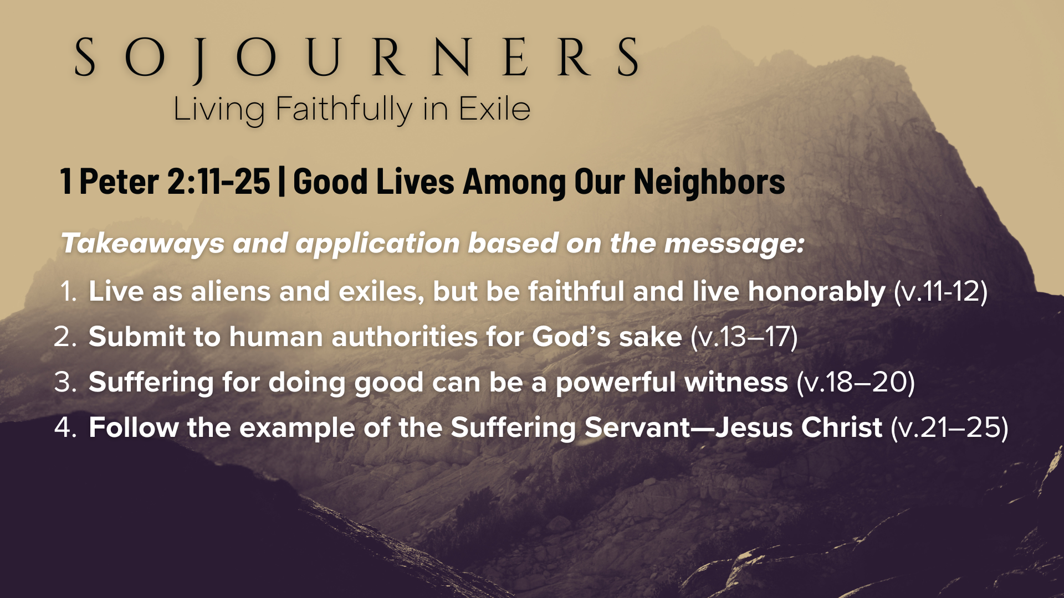
Notes:
Live as aliens and exiles, but be faithful and live honorably (v.11-12) We are called to moral integrity not just for our own sake, but as a form of public witness. Even in a hostile culture, our lives should provoke curiosity, not contempt.
Submit to human authorities for God’s sake (v.13-17) We should model respect, honor, and civic responsibility, not rebellion or disrespect—even when institutions are flawed (and they always are)—because such behavior silences critics and glorifies God.
Suffering for doing good can be a powerful witness (v.18-20) In the face of hardship—especially unjust treatment—we are called to endure without retaliation, trusting that God sees and will vindicate. This is our counter-cultural witness. Our “good lives” will go a long way in God opening unbeliever’s eyes to their unbelief, misbehavior, and mistreatment if we will endure suffering as Christ does.
Follow the example of the Suffering Servant—Jesus Christ (v.21-25) The Christian life is cruciform—shaped by the cross. As disciples, we are called not just to believe in Jesus, but to imitate his way of suffering love. This includes forgiving, enduring mistreatment, and doing good… even to enemies.
And to sum all of that up, Peter is saying:
Live distinctively in a watching world
Submit and respect authority as part of Christian mission
Endure injustice with grace
Imitate Christ’s example of non-retaliation, trust in God, and redemptive suffering
Can you think of a modern-day example of this being lived out? [NEXT SLIDE]

Slide 15
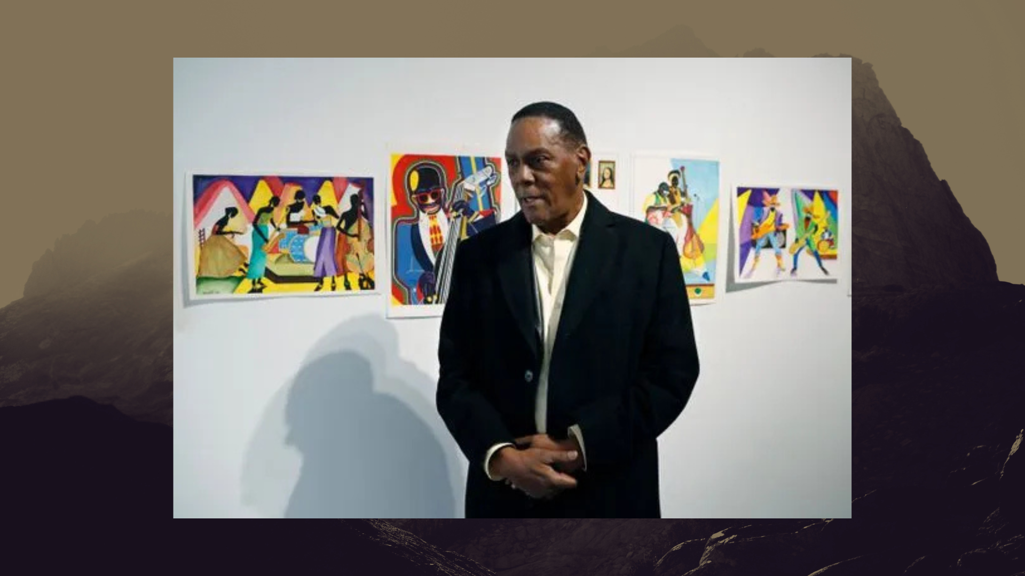
Notes:
In 1972, Richard Phillips was wrongfully convicted of murder in Detroit. He was 27 years old at the time. The conviction was based on false testimony and flawed legal processes. For decades, he maintained his innocence, refusing to take a plea deal or admit guilt in exchange for a shorter sentence—because doing so would have meant lying and abandoning the truth. He spent 45 years in prison, making him one of the longest-serving wrongfully incarcerated people in U.S. history.
Throughout that time, he turned to painting, reading Scripture, and encouraging others in prison. He became known for his calm spirit and for helping younger inmates find meaning and direction. Despite the injustice, he didn’t grow bitter. He clung to hope and trusted that truth would one day win.
In 2018, with the help of the University of Michigan's Innocence Clinic and new testimony that proved he had been falsely accused, Phillips was exonerated and released at age 73. The prosecutor publicly admitted that Phillips should never have been imprisoned. He was later awarded a settlement from the state, but more importantly, his name was cleared.
When asked how he endured, Phillips pointed to his faith in God. “I never gave up on God. He knew I didn’t do it,” he said. Instead of becoming vengeful, he resumed painting and used his story to inspire others, advocating for justice reform and the power of perseverance. A powerful reminder that even in long seasons of injustice, hope and integrity can endure, and God is still working behind the scenes to bring the truth to light.
Finally, here are some questions to help us reflect on what we’ve heard and respond to how the Spirit is leading us this morning…

Slide 16
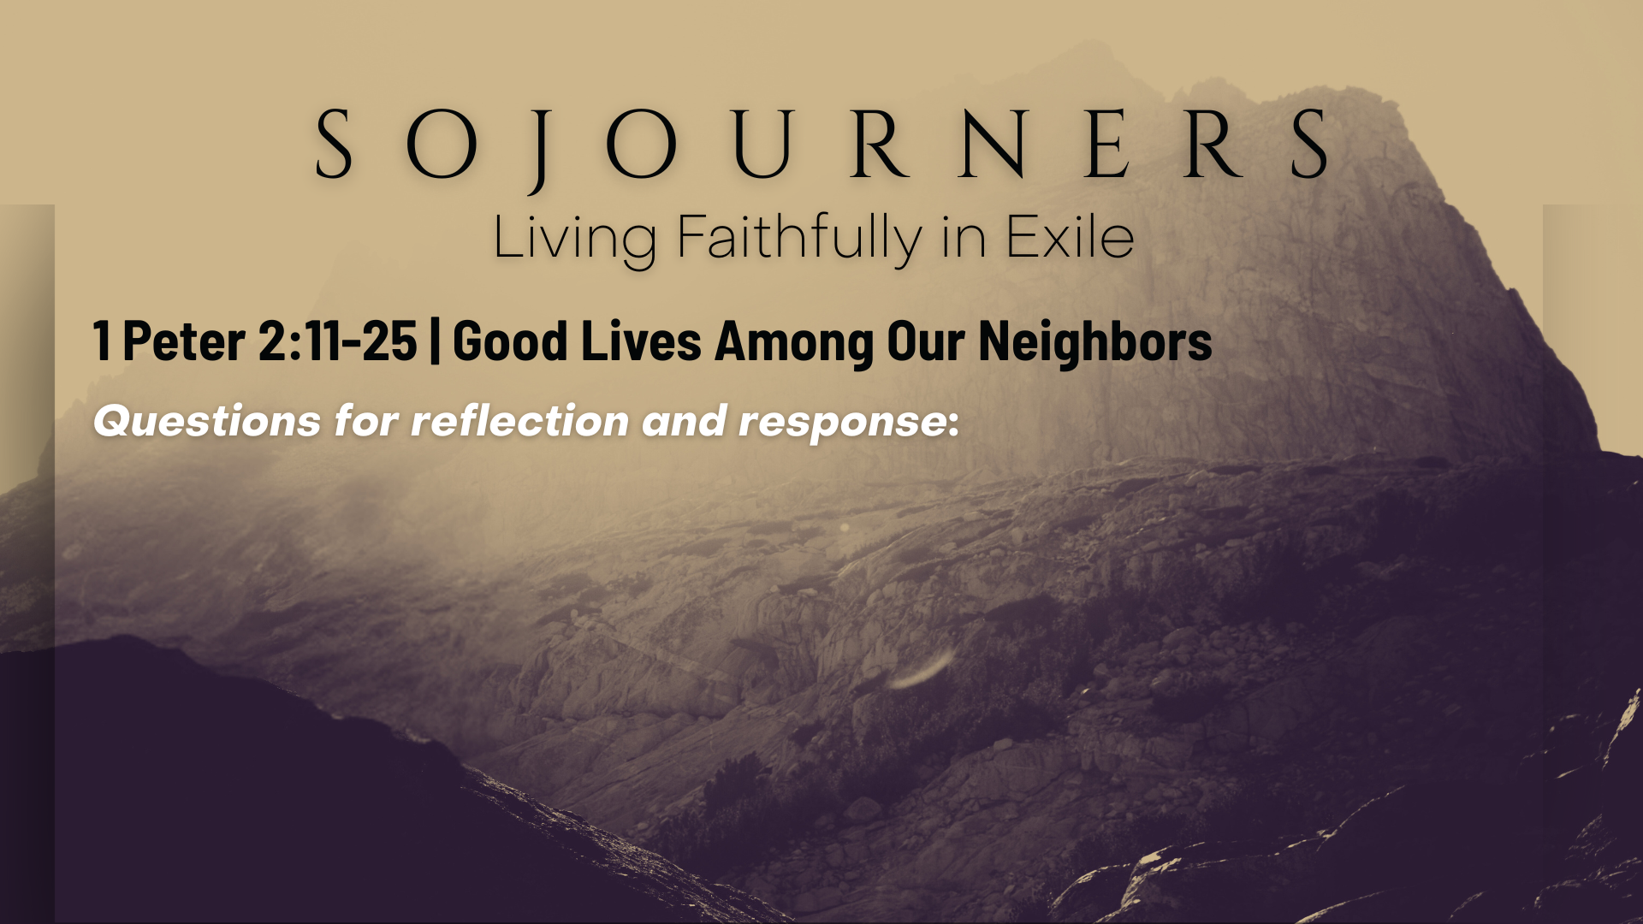

Slide 17
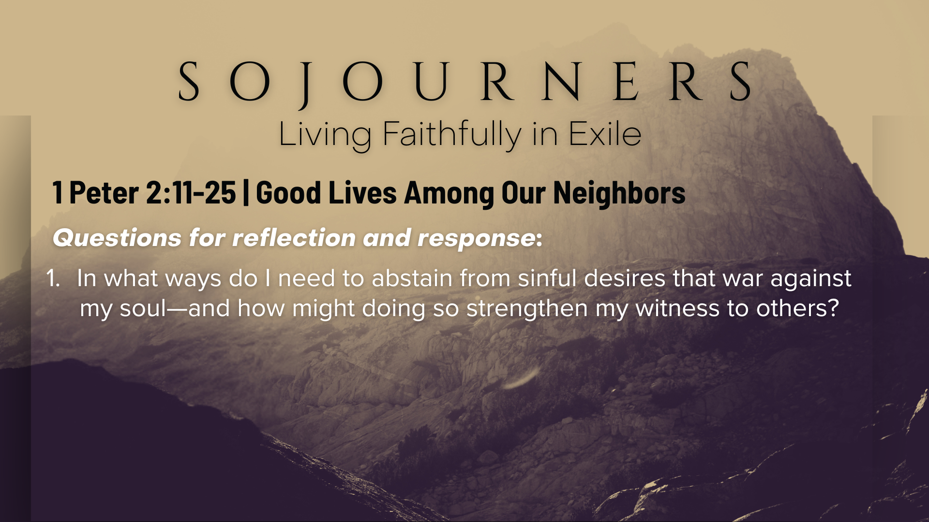

Slide 18
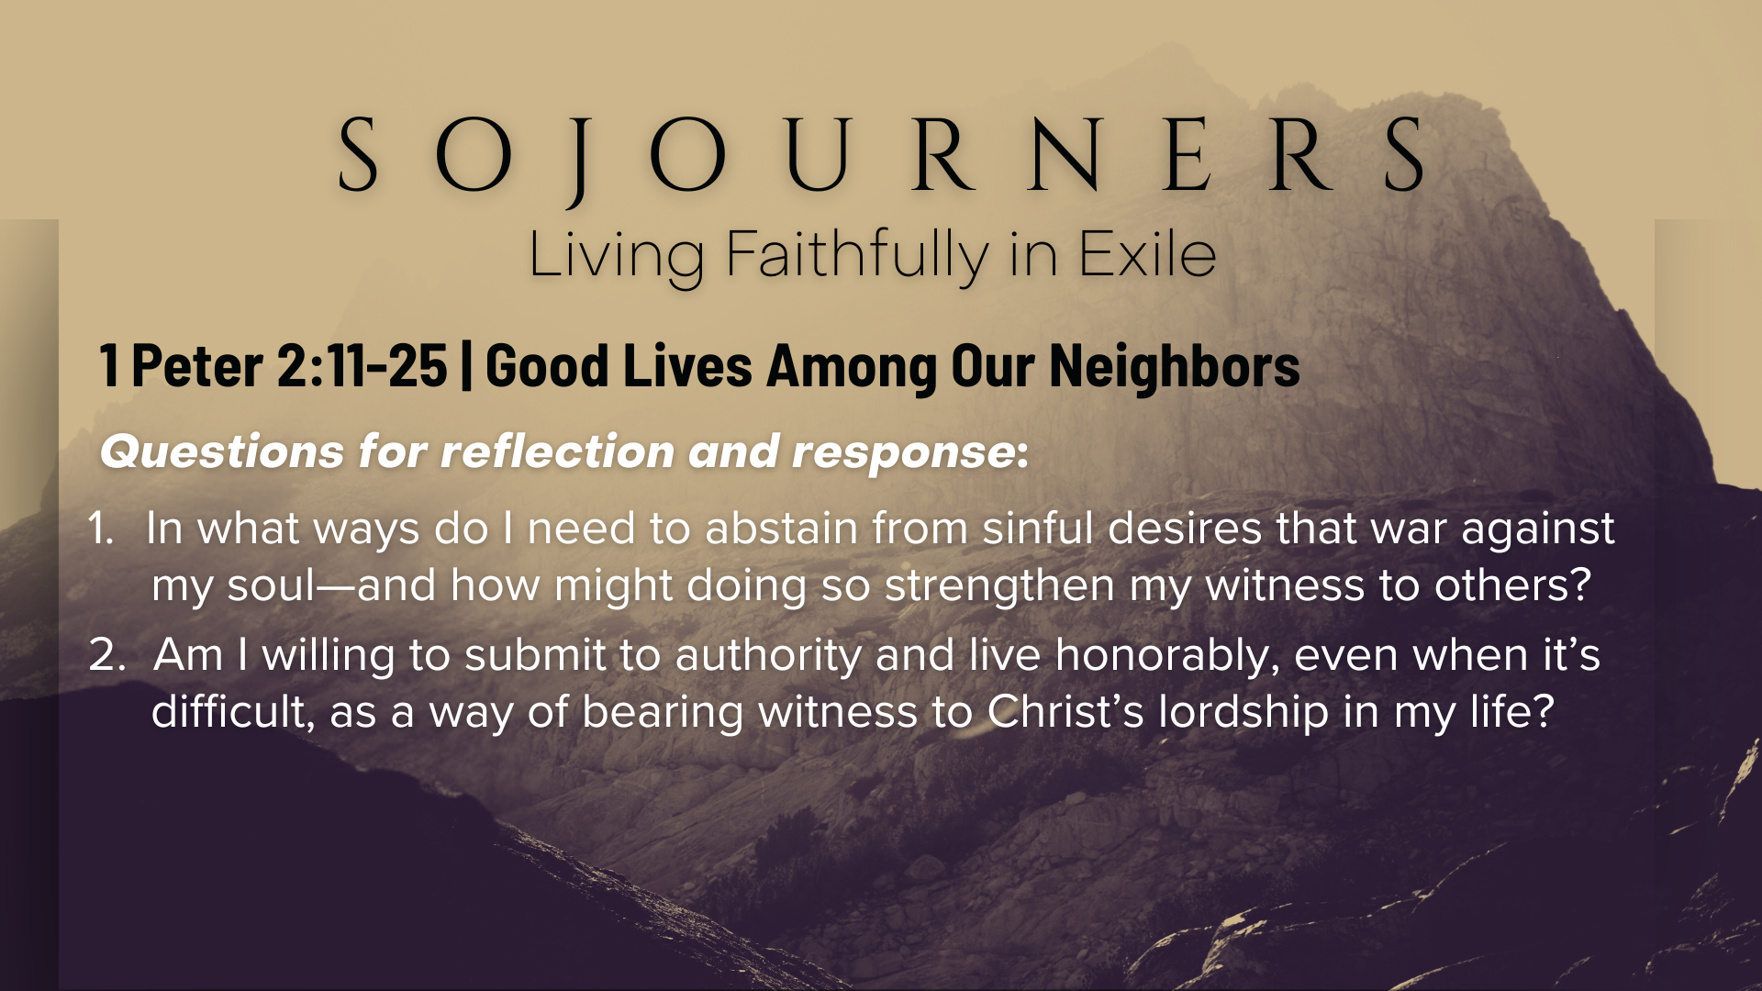

Slide 19
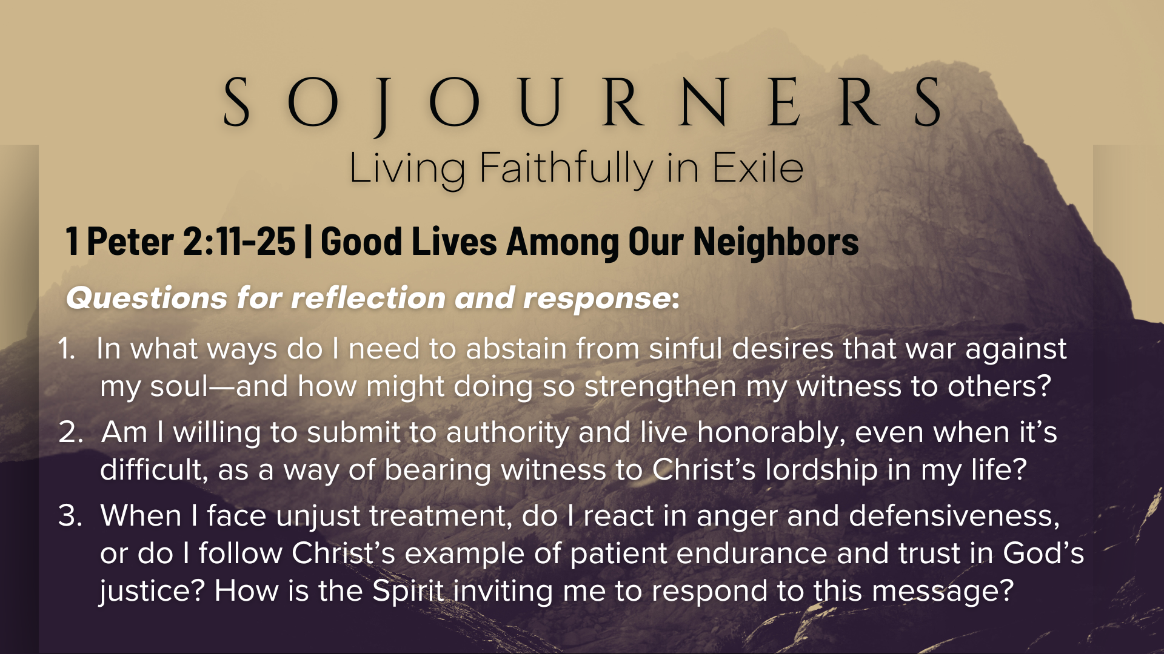
Notes:
[READ & BRIEF COMMENT ON EACH QUESTION]
In what ways do I need to abstain from sinful desires that war against my soul—and how might doing so strengthen my witness to others?
Am I willing to submit to authority and live honorably, even when it’s difficult, as a way of bearing witness to Christ’s lordship in my life?
When I face unjust treatment, do I react in anger and defensiveness, or do I follow Christ’s example of patient endurance and trust in God’s justice? How is the Spirit inviting me to respond to this message?
[CLOSING WORDS]
Let’s pray… [NEXT SLIDE FOR CLOSING PRAYER]

Slide 20
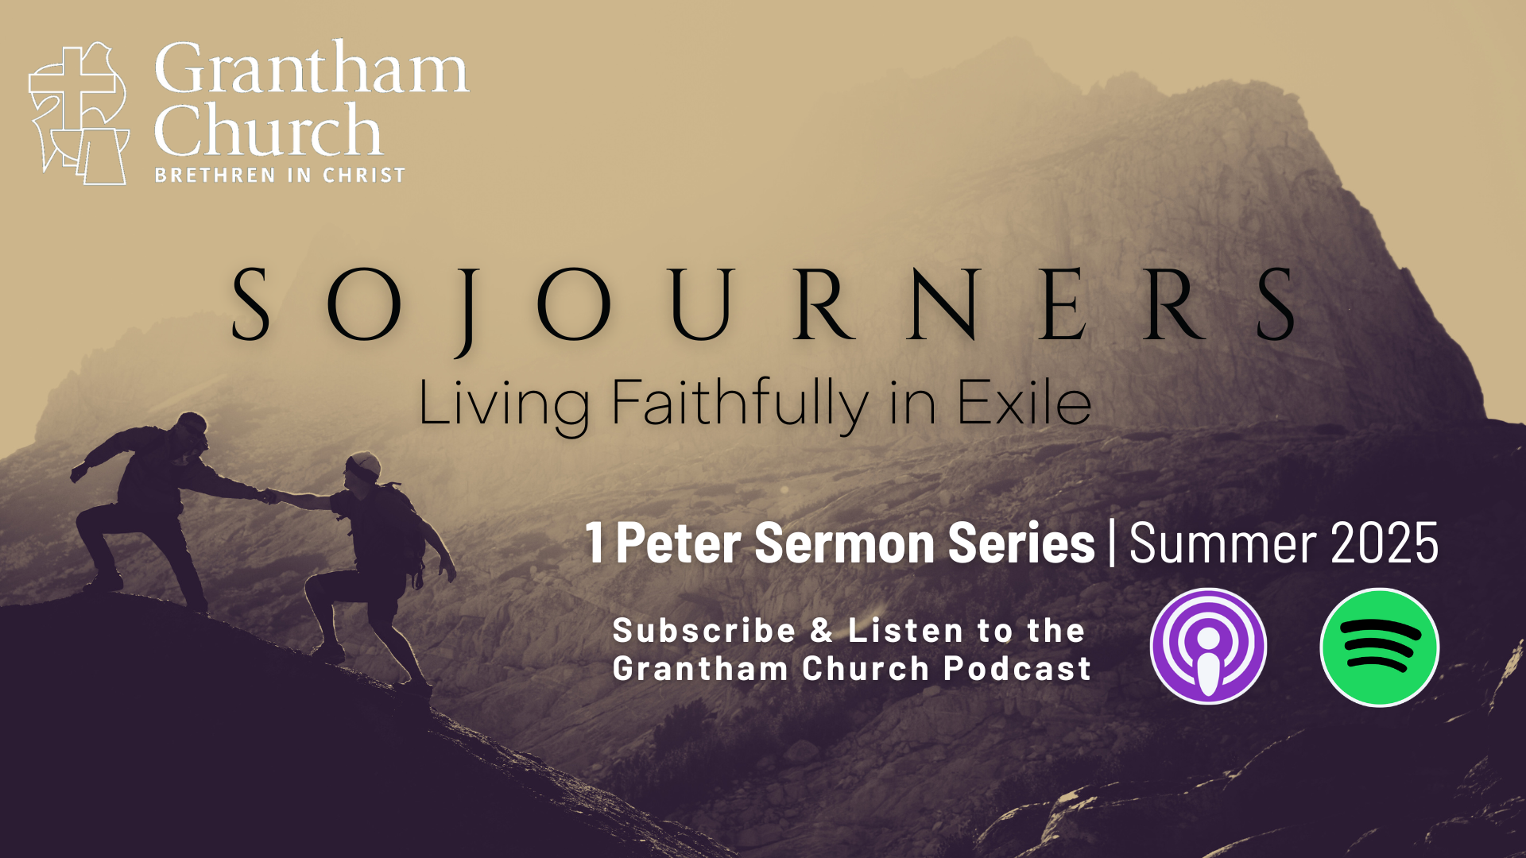
Notes:
[CLOSING PRAYER]
Benediction
Chosen people of God, as sojourners and exiles in this world,
set your hearts on the Living Hope – Christ risen and reigning.
As you go into the world,
may you walk in hope,
stand firm in God’s grace,
shine with the love of Jesus,
and allow the Spirit to sustain you in all things,
until the day your sojourning gives way to glory.
Go in peace, church,
and live faithfully in exile.
Amen.

